Slide 1
Booki Website

Slide 2
Overview
Context of the project
Visuals (desktop, tablet, mobile)
Code
Filters
Activities cards
Summary

Slide 3
Context of the project
Holiday planning tool for Booki
Find accommodation and activities in a specific town
Filter by budget, atmosphere etc
I have made the index.html and css style for the home page.

Slide 4
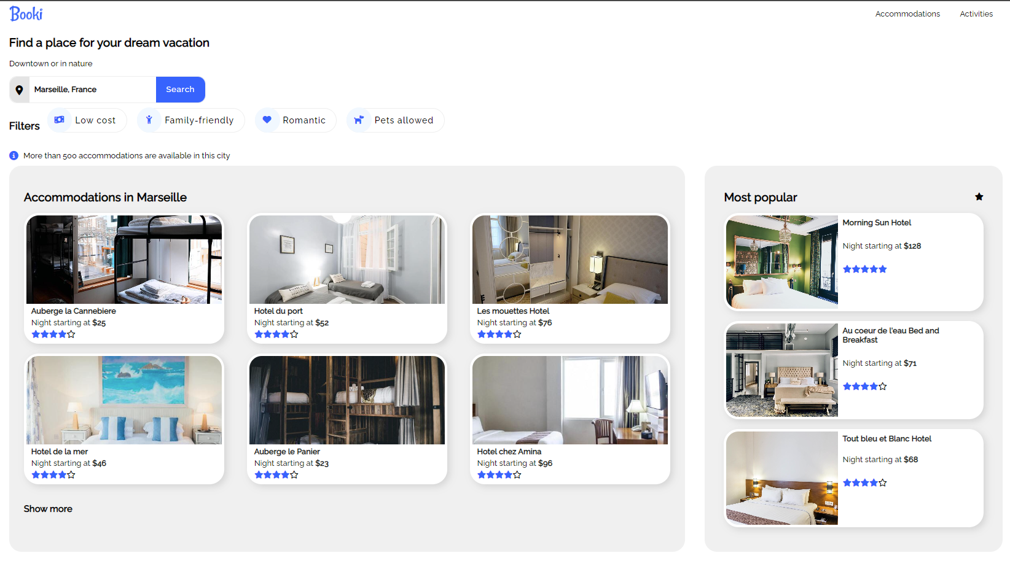
Visuals – Desktop

Slide 5
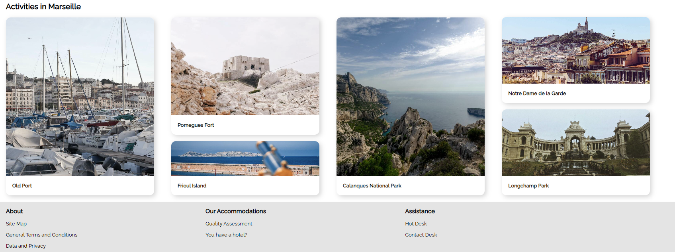
Visuals - Desktop

Slide 6
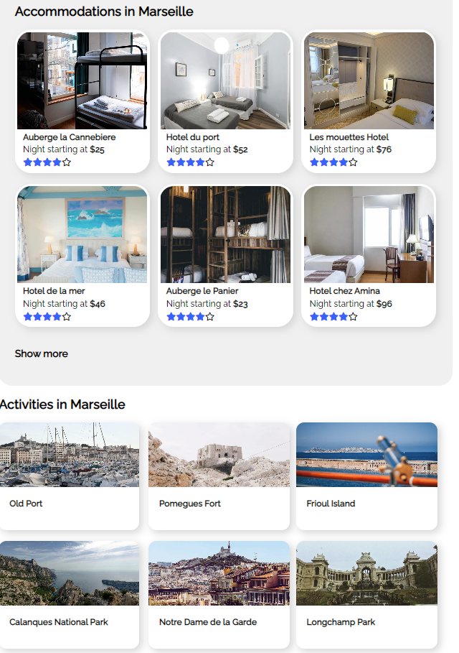
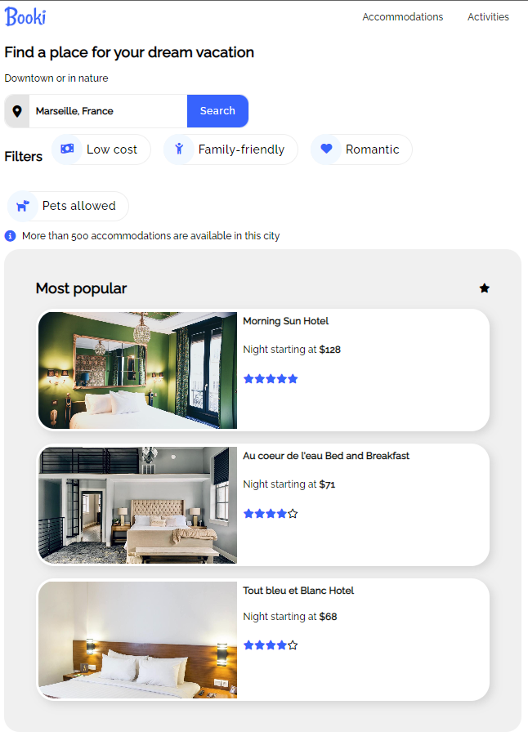

Visuals - tablet

Slide 7
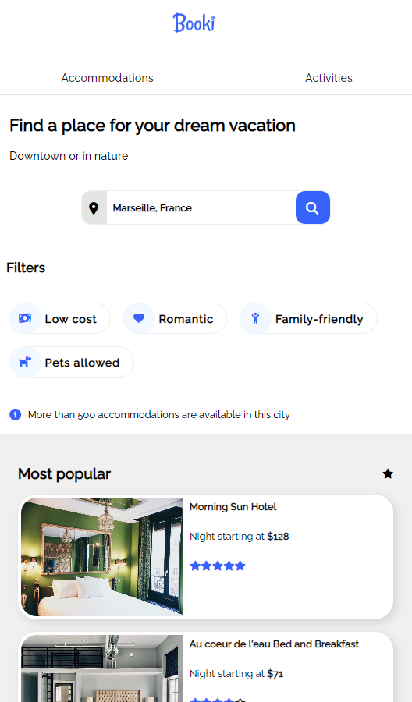
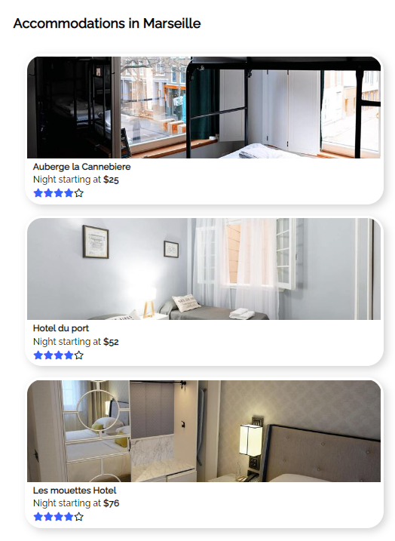
Visuals - Mobile

Slide 8
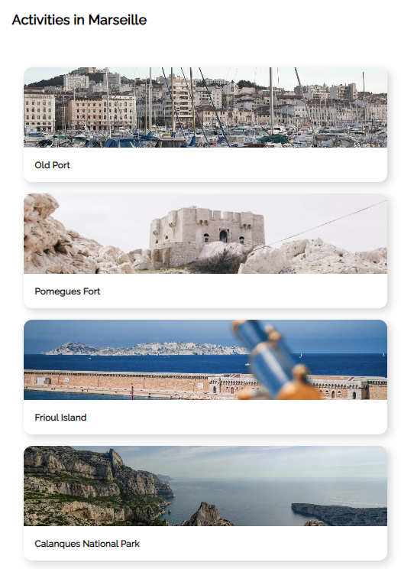
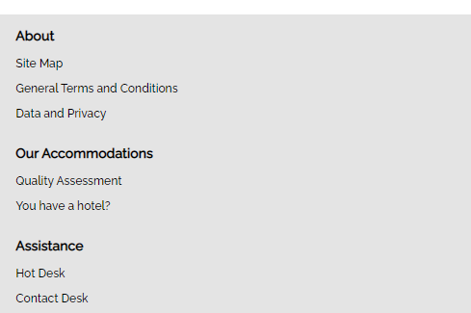
Visuals - Mobile

Slide 9
Code - filters
Requirement:
Having a filter that required some behaviour when interacted with

Slide 10
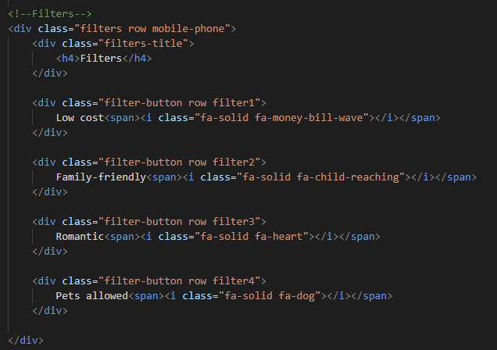
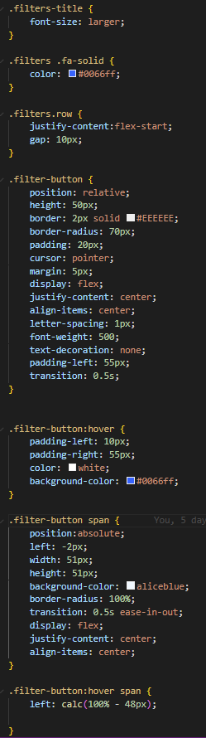
Code – Filters
Requirement:
Having a filter that demonstrated some behaviour when interacted with
The challenge:
What kind of behaviour should it show?
How to make it visually appealing?

Slide 11
Code - filters
Solution:
On hover, the icon swipes right
Transition: ease-in-out was used to make the change look modern and appealing
I spent a lot of time making sure the icon moved to the correct location and looked good

Slide 12
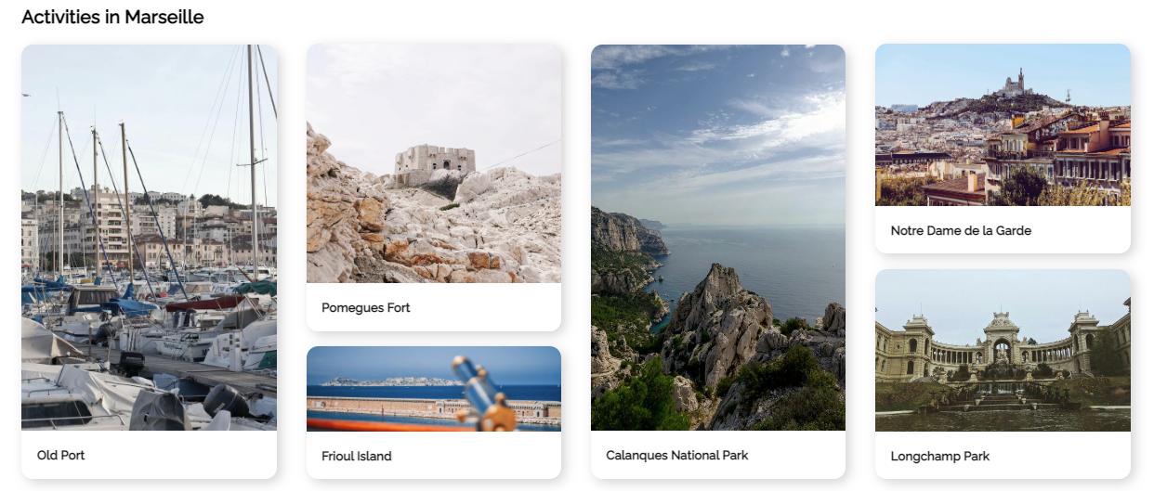
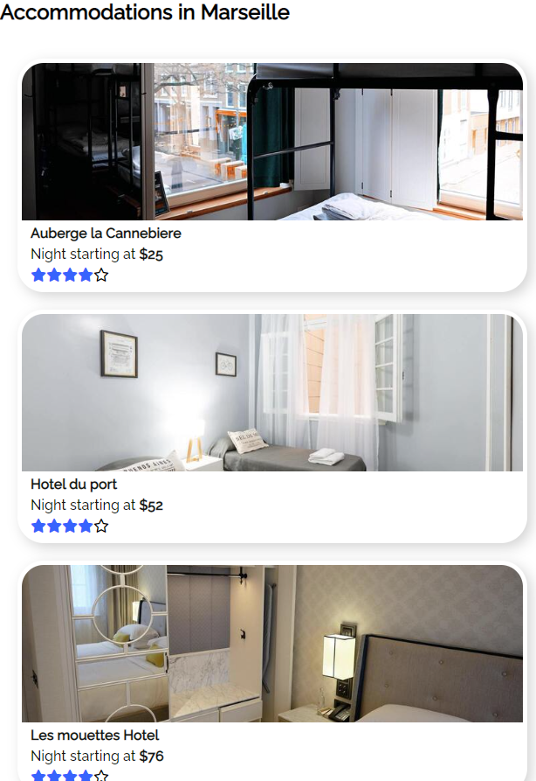
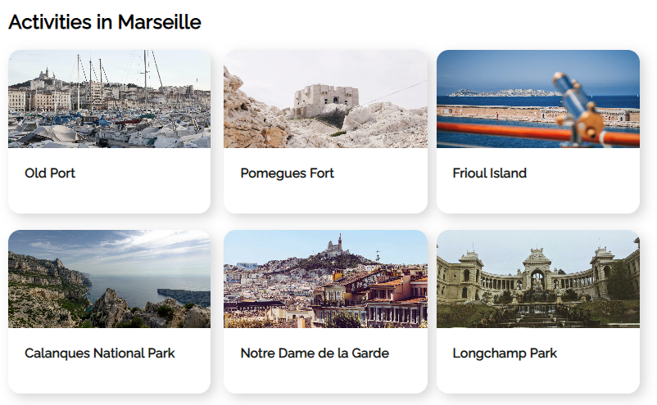
Code – activities cards
Desktop
Requirement
Desktop - Six cards with four different sizes in one row
Tablet – two lines of three cards
Mobile – single column
Challenges
Different card and image sizes at the desktop size
Different number of cards in rows
Mobile
Tablet

Slide 13
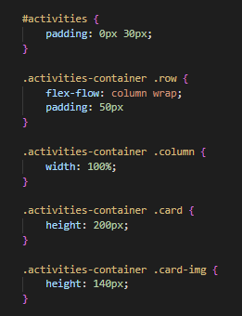
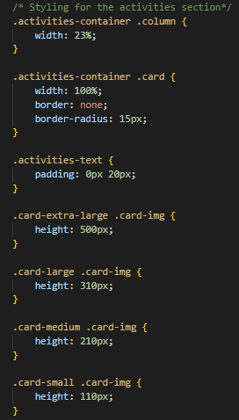
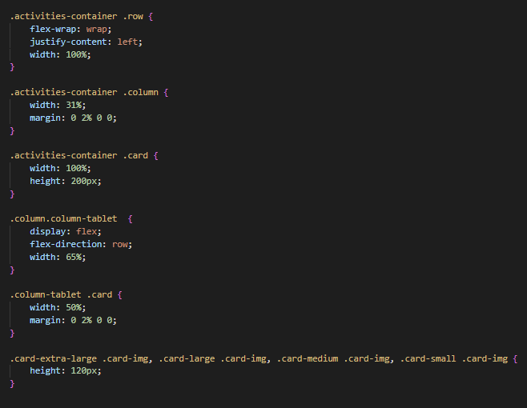
Code – activities cards
Mobile
Solutions
Using specificity to select the specific elements I wanted to change so that others will not be affected
Using media queries and assigning specific card sizes at tablet and mobile phone levels
Desktop
Tablet

Slide 14
Summary
What went well:
Very close to the mock up
Visually appealing filters
Visually appealing tablet layout
Even better if:
Making sure all cards match up perfectly
Eliminating any excess code
Ensuring the colour scheme matches the mock up

